Slide 1

Capstone Project
Group 231 - 04
Department of EEE | 2024

Slide 2

1
Project Title
Implementation of ECG
in Biometric Authentication.
Department of EEE | 2024
Presented By
Anamika Deb Nath ; ID: 021 163 012

Slide 3
2
Members
Anamika Deb Nath
021 163 012
Rafiur Rahman Abir
021 191 037
Md. Mahmudul Islam
021 182 030
Md. Arafat Islam
021 191 073
Ayman Zafar
021 191 058

Slide 4

Acknowledgement
Mentor
Dr. Md. Iqbal Bahar Chowdhury
Associate Professor,
Department of EEE, UIU
Department of EEE| Group 232-04 | United International University

Slide 5
Introduction
4
Serious security concerns of identity theft nowadays.
Importance of Unique Identity
Challenges with Traditional Authentication
The Rise of Biometrics
Advantages of Biometrics
Department of EEE | 2024
Presented By
Anamika Deb Nath; ID: 021 163 012

Slide 6





Biometric Authentication
5
Fingerprint Recognition
Facial Recognition
Voice Recognition
Iris
Recognition
limitations
latex gel/ dummy finger
Fake face masks
Recorded synthesized voice
Contact Lenses
Department of EEE | 2024
Presented By
Anamika Deb Nath ; ID: 021 163 012

Slide 7
6
New Technology
ECG-Based Real-Time Biometric Authentication
Why ECG?
Challenges Addressed.
Department of EEE | 2024
Presented By
Rafiur Rahman Abir 021 191 037

Slide 8
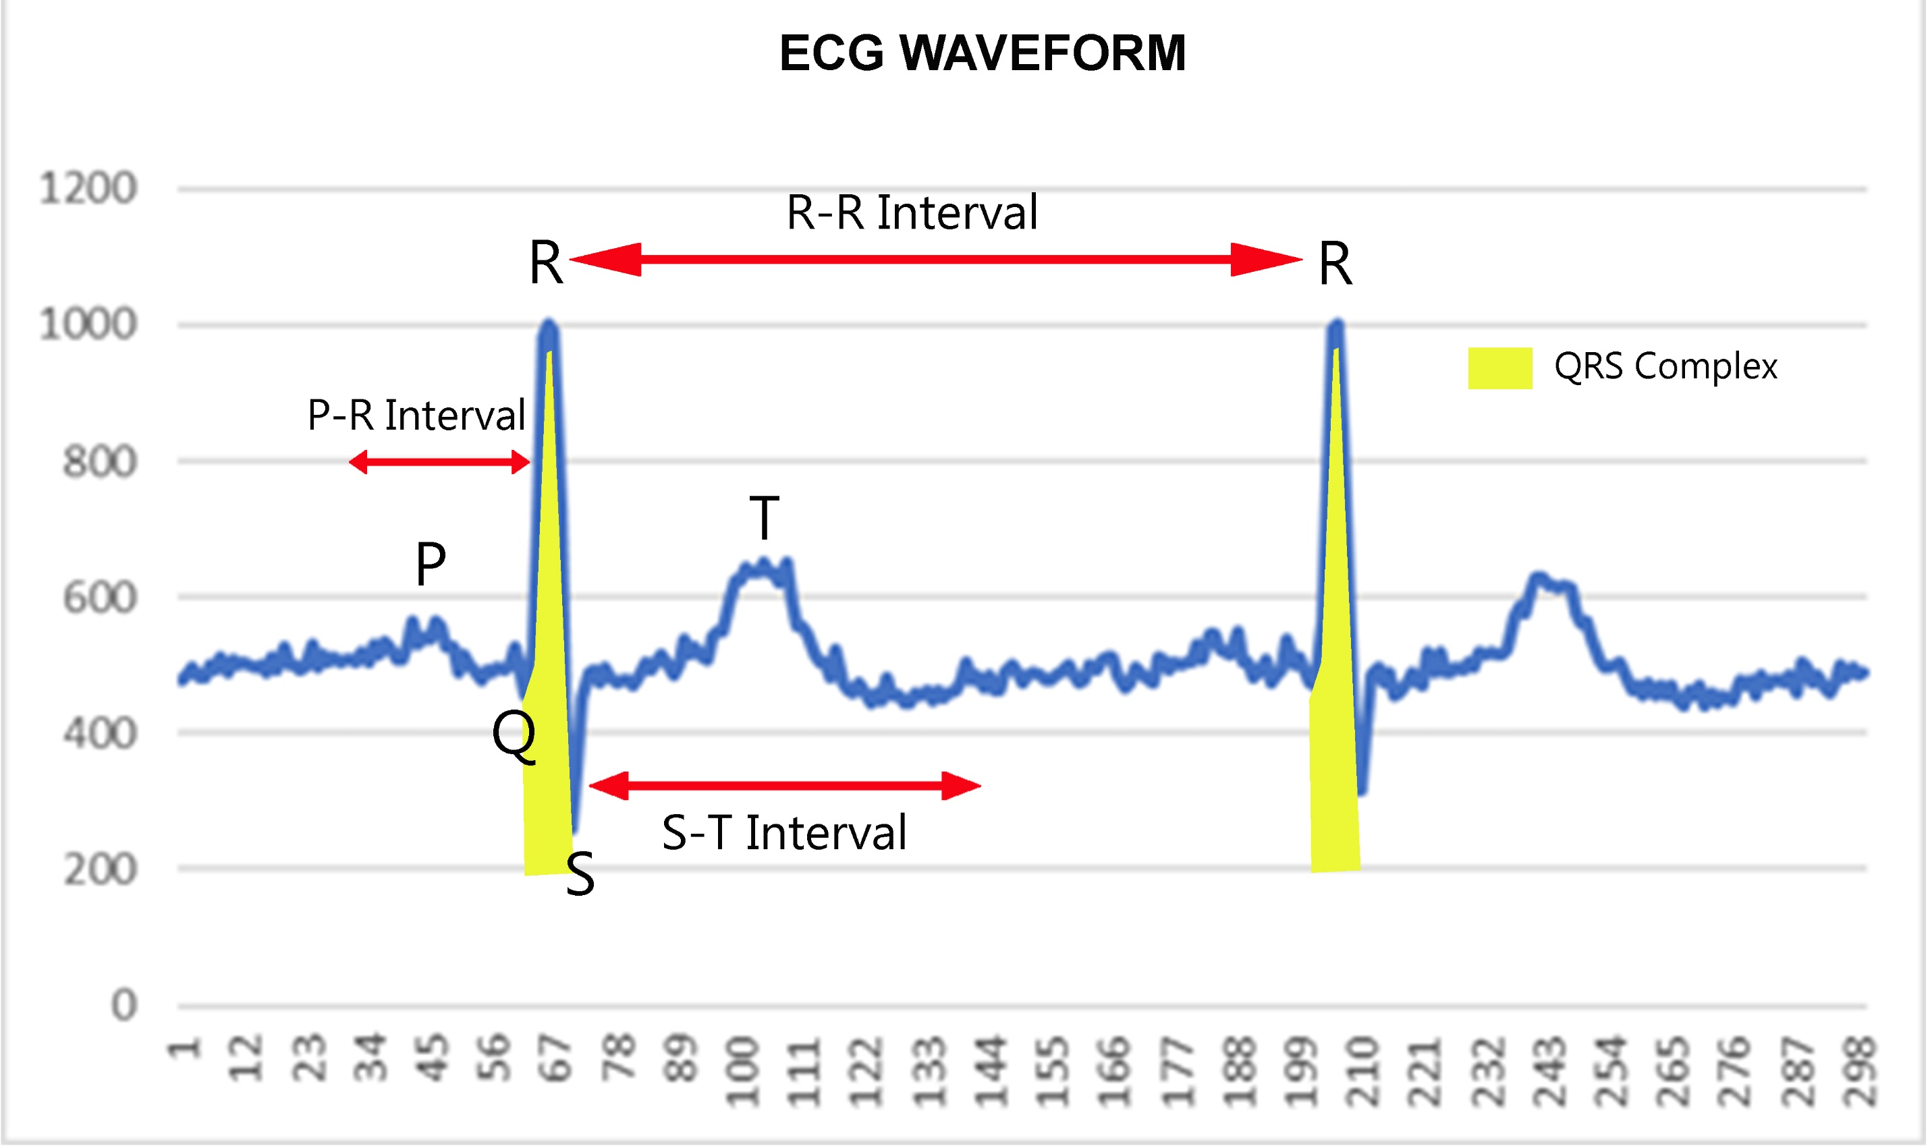
7
Unique Features
Interval
Amplitude
Angle
Area
Peak
Department of EEE | 2024
Presented By
Rafiur Rahman Abir 021 191 037

Slide 9
Challenge in ECG-Based Authentication
8
Hardware Requirements.
Pre-Processing.
Core Processing
Department of EEE | 2024
Presented By
Rafiur Rahman Abir 021 191 037

Slide 10
9
Project Aim
Develop an ML framework for ECG-based authentication
Design portable hardware for real-time ECG data collection
Department of EEE | 2024
Presented By
Rafiur Rahman Abir 021 191 037

Slide 11
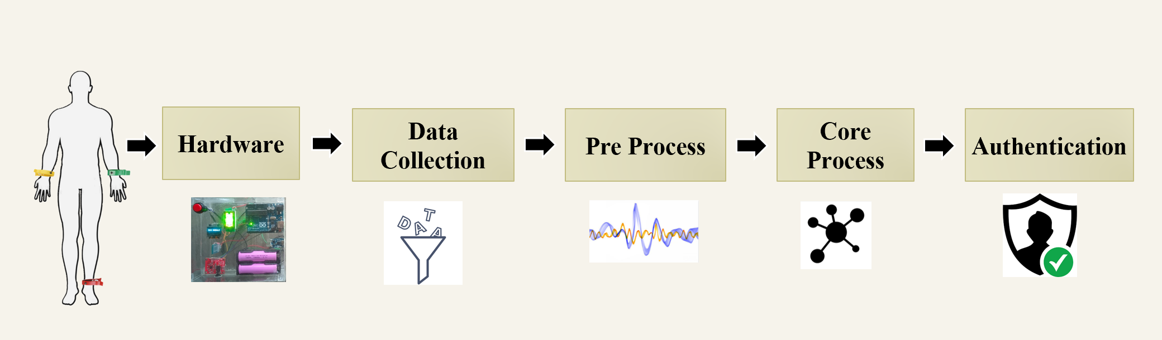
10
Overall System Flow Chart
Department of EEE | 2024
Presented By
Rafiur Rahman Abir 021 191 037

Slide 12
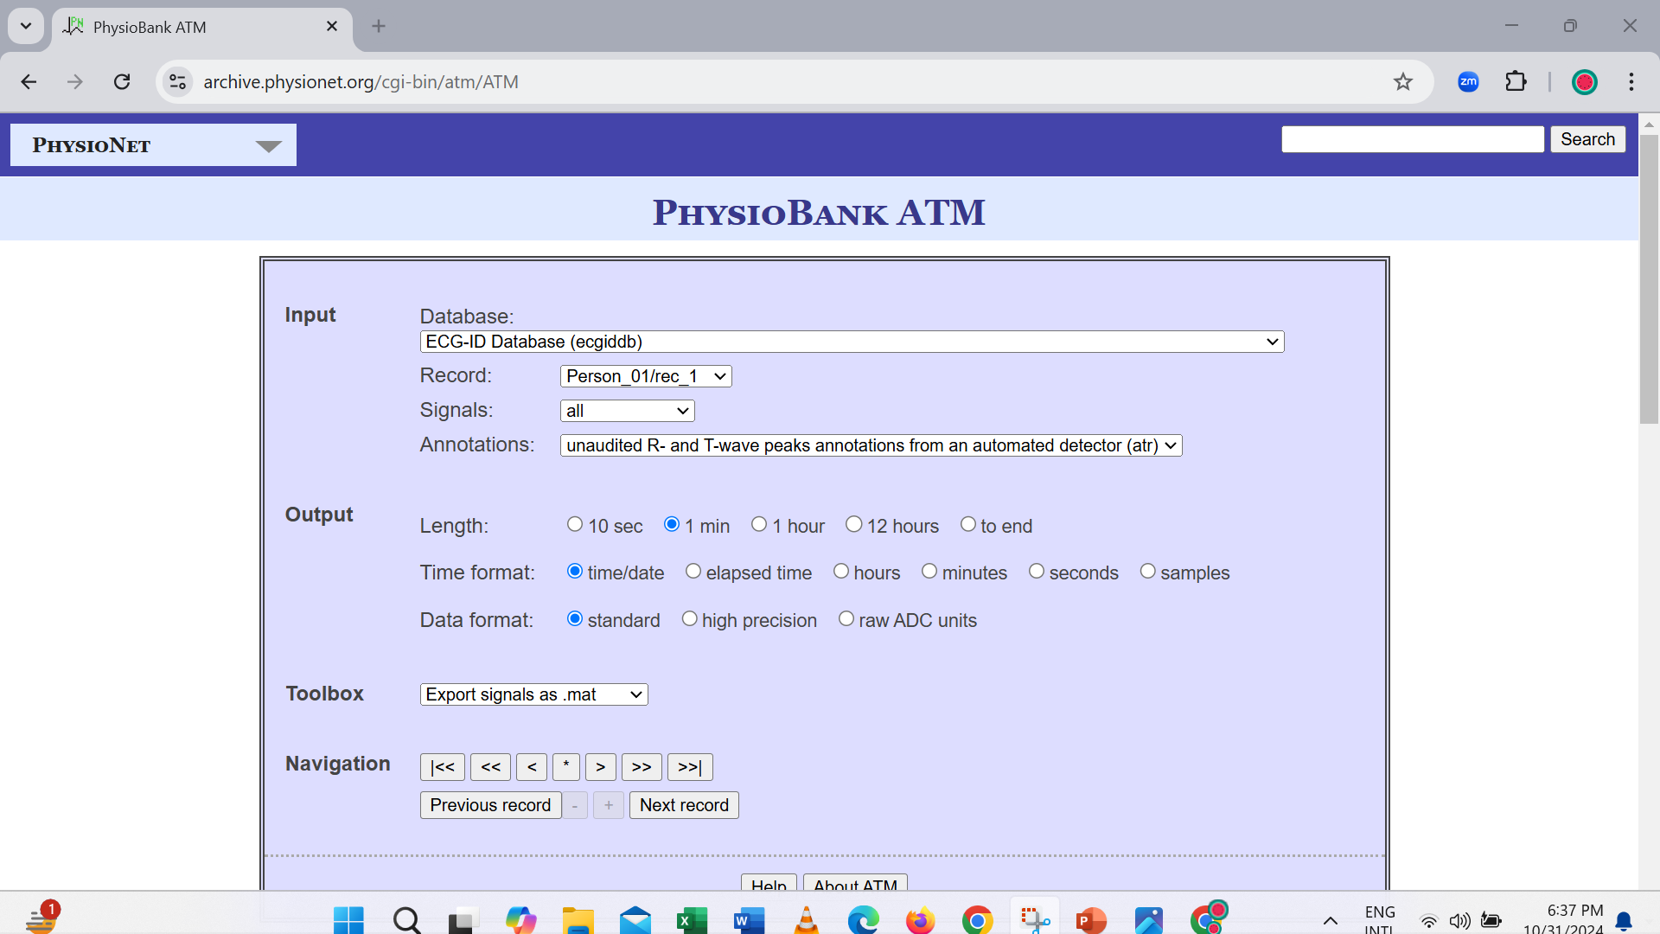
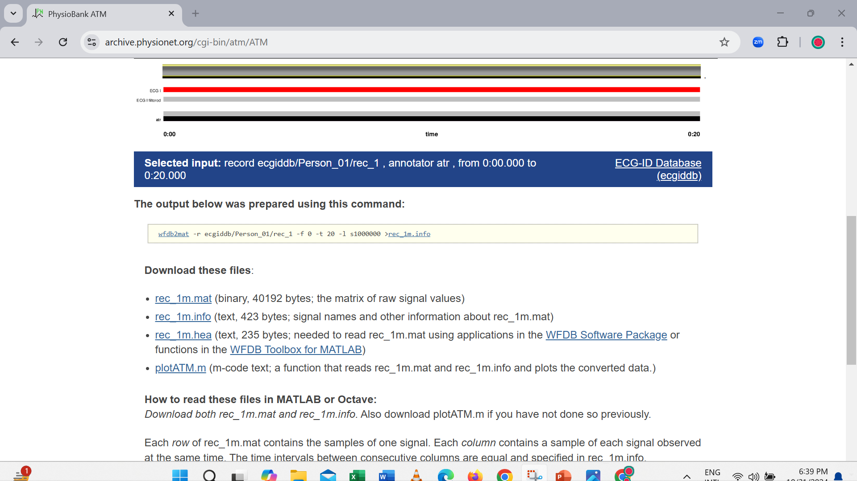
Physio bank
11
Department of EEE | 2024
Presented By
Mahmudul Islam ; ID: 021 182 030

Slide 13
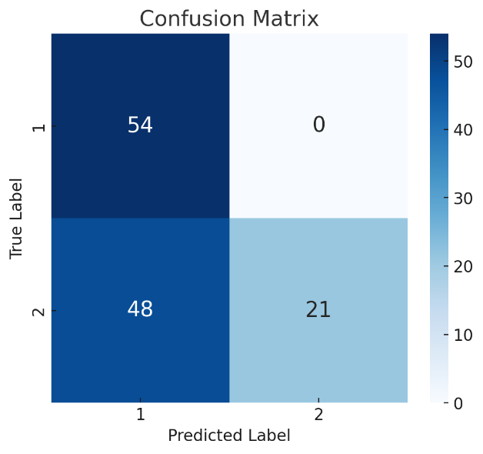
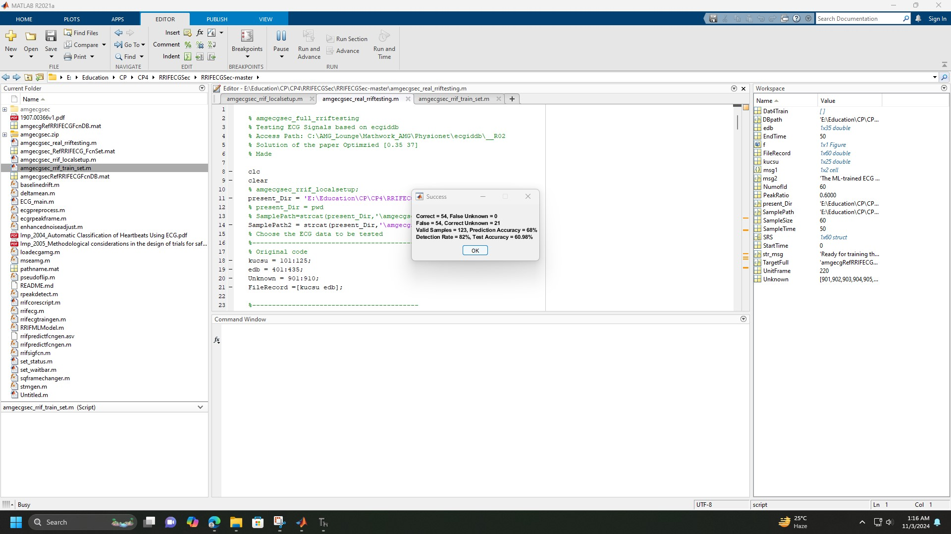
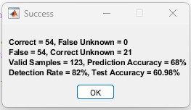
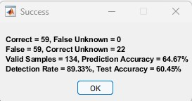
12
Confusion Matrix(Physio Bank)
Department of EEE | 2024
Presented By
Mahmudul Islam ; ID: 021 182 030

Slide 14
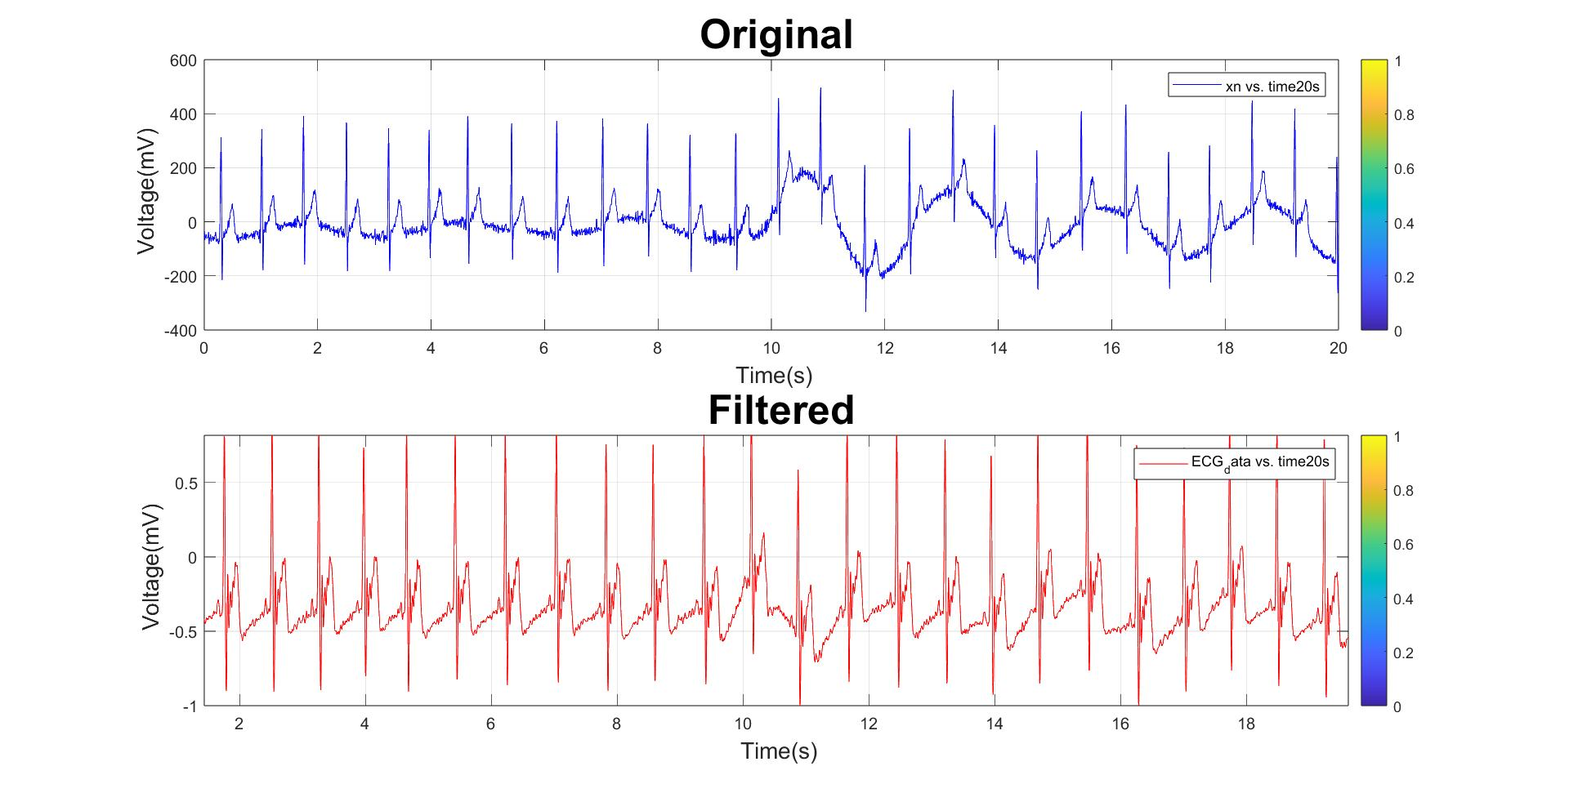
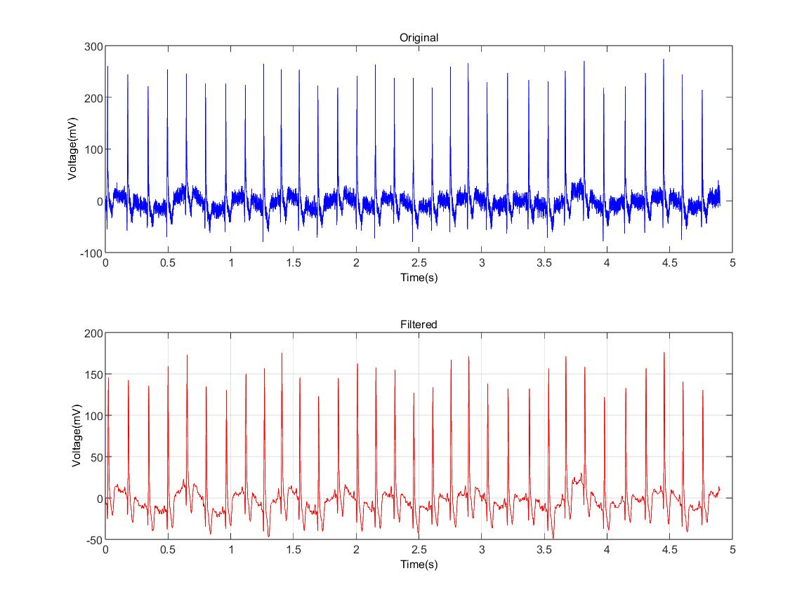
Pre-Process
13
Baseline Wander Adjustment
Power Line Interface
Department of EEE | 2024
Presented By
Arafat Islam ; ID: 021 191 073

Slide 15
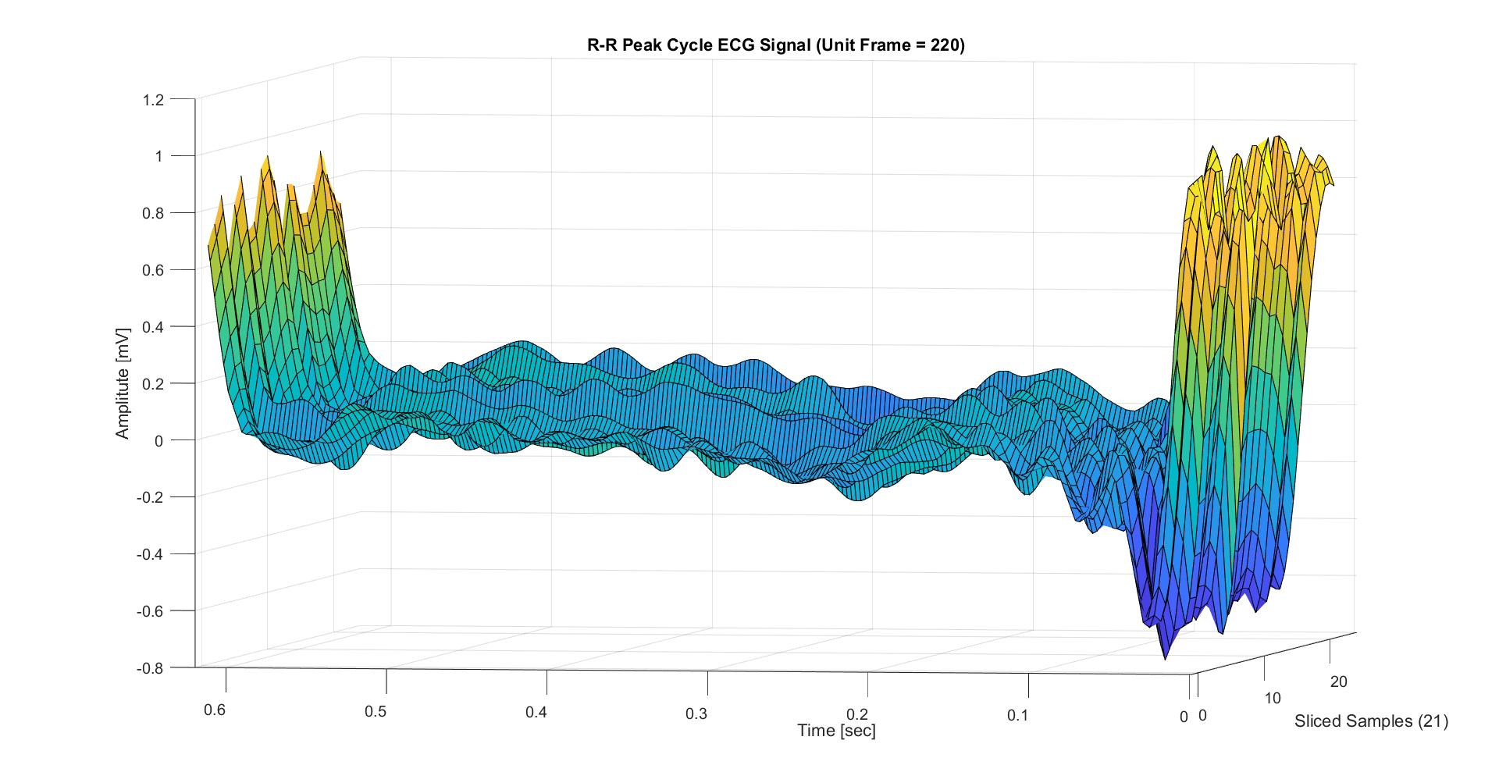

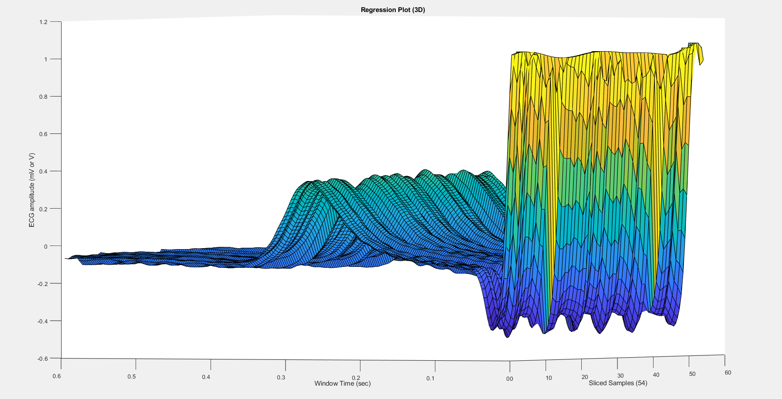
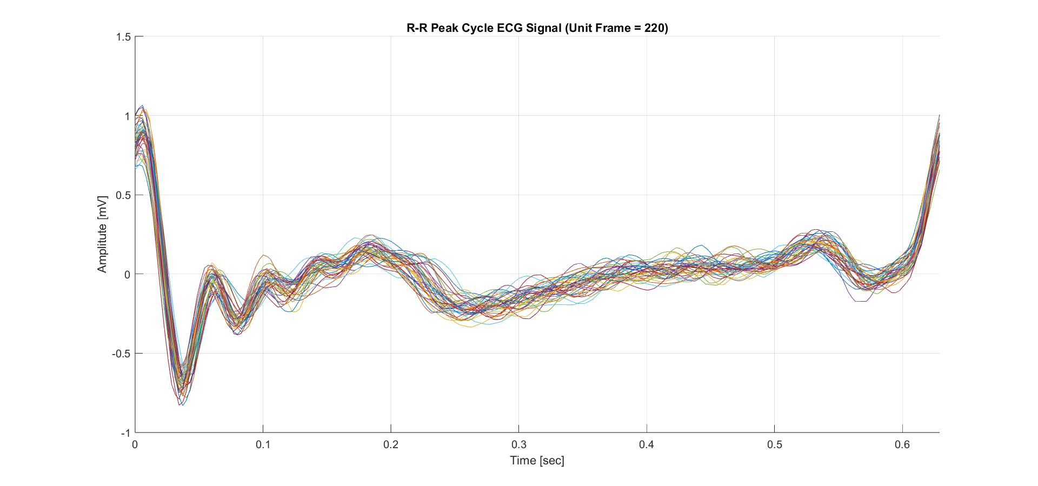
Core Process
14
Department of EEE | 2024
Presented By
Arafat Islam ; ID: 021 191 073

Slide 16

15
Flow Chart
Training Phase
Testing Phase
ECG data for Training
New ECG entry for Authentication
Pre-process
Pre-process
Core-process
(Machine Learning)
Validation Process within Data Base
Unknown
Reference
Authentication
Department of EEE | 2024
Presented By
Arafat Islam ; ID: 021 191 073

Slide 17
16
Confusion Matrix
Department of EEE | 2024
Presented By
Arafat Islam ; ID: 021 191 073

Slide 18

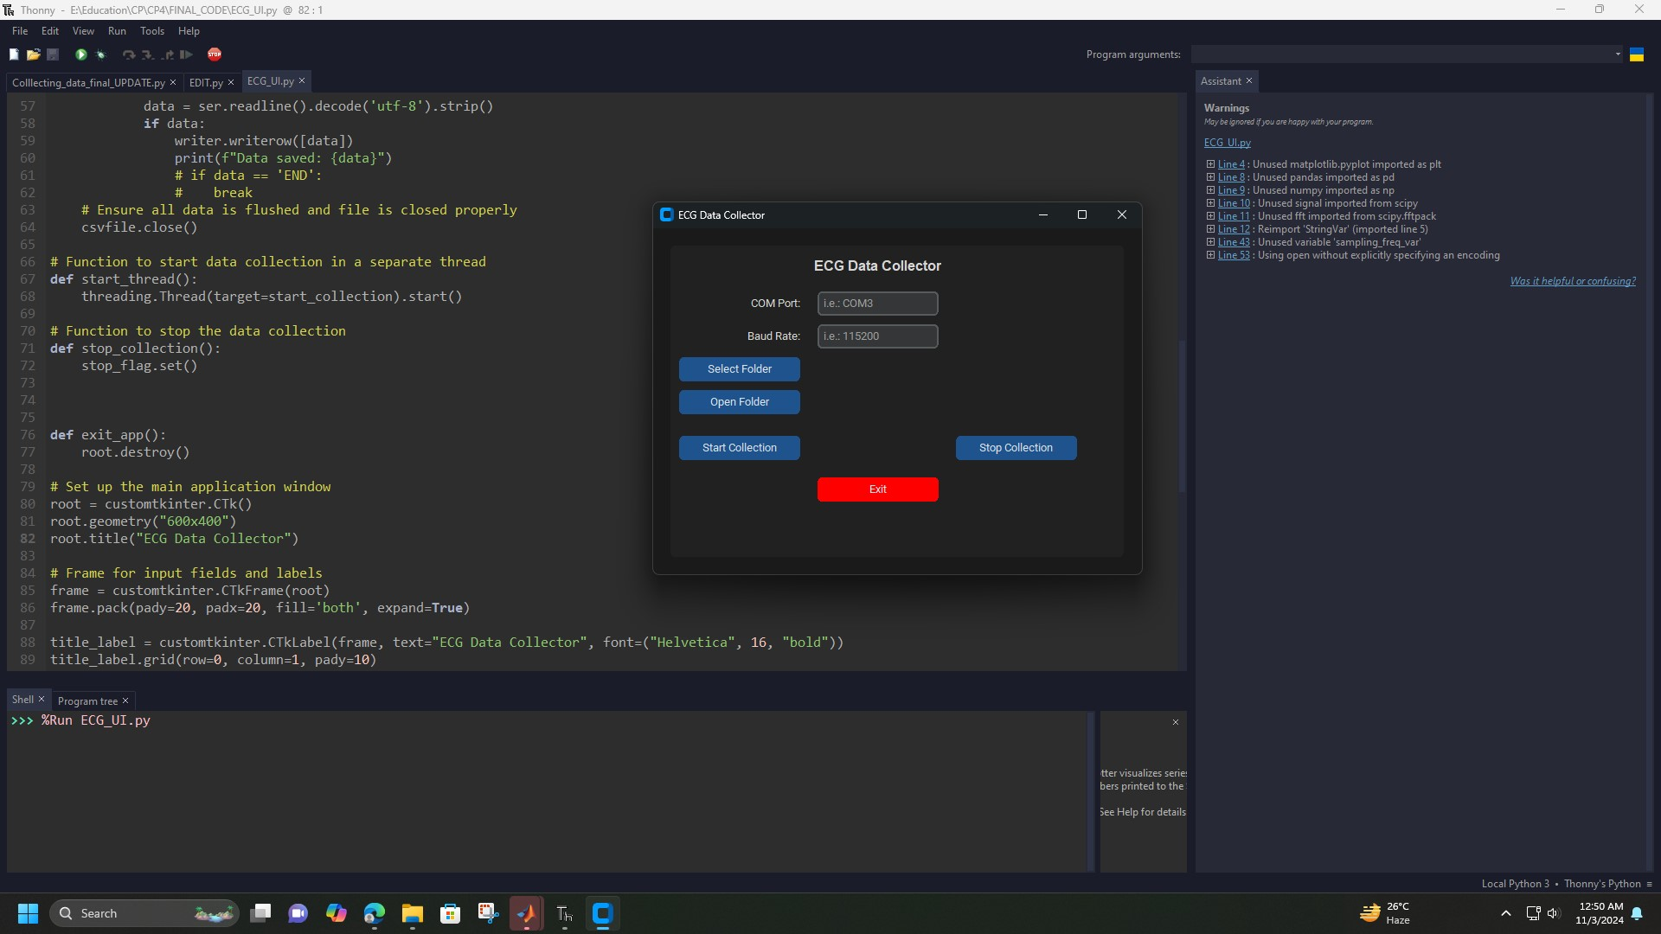
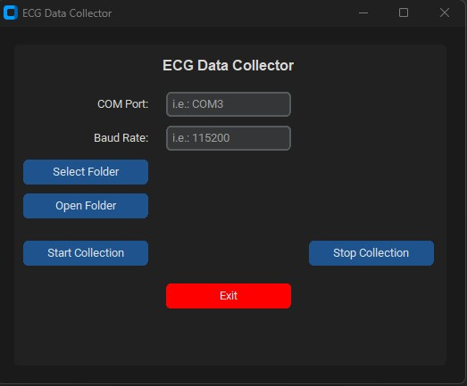
User Interface
17
Department of EEE | 2024
Presented By
Arafat Islam ; ID: 021 191 073

Slide 19
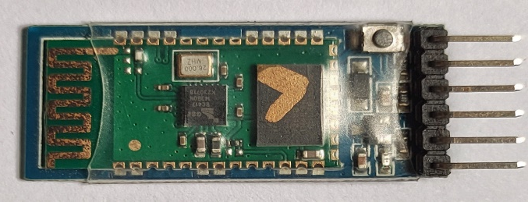
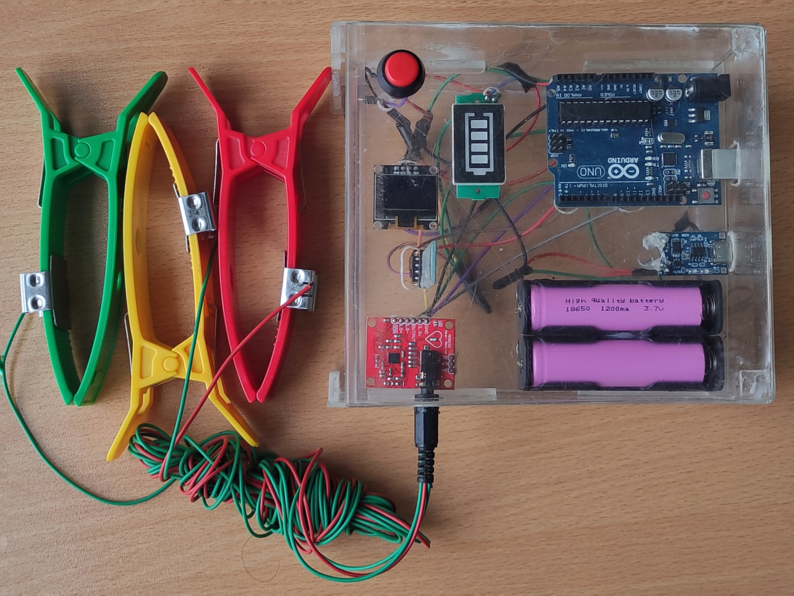
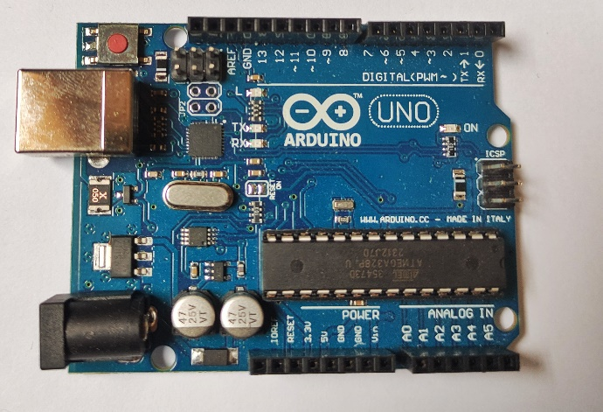
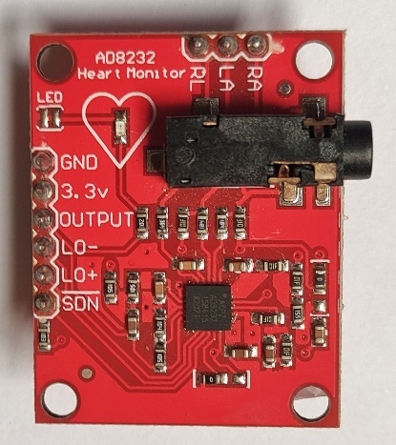
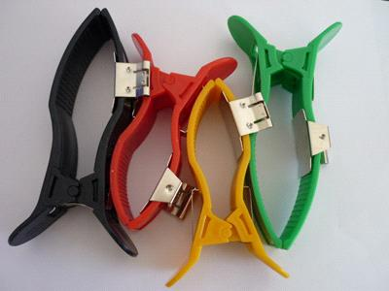
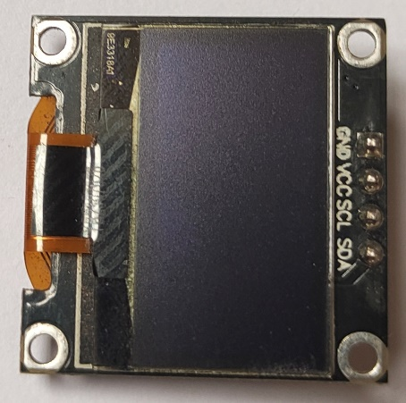
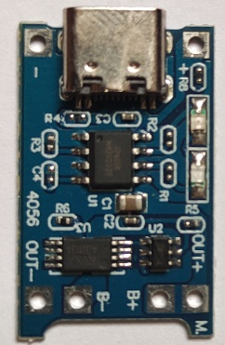
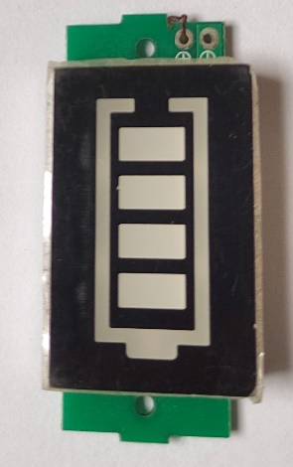
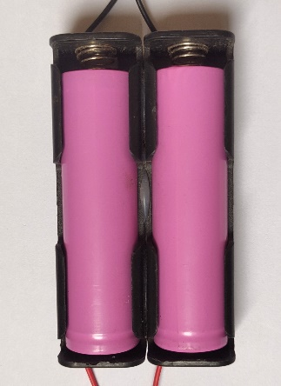
Components
18
Hardware
Bluetooth Module
Arduino Uno
AD8232(ECG Module)
Electrodes
OLED Display
Charge Indicator
Battery
Battery Charging
Module
Department of EEE | 2024
Presented By
Ayman Zafar ; ID: 021 191 058

Slide 20
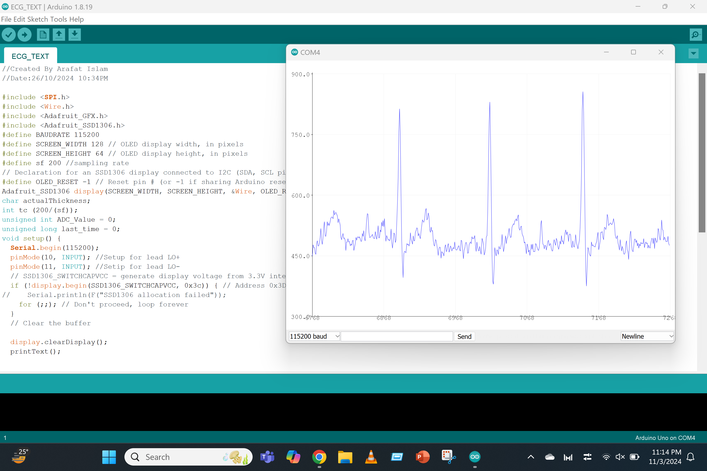
Arduino Output
19
Department of EEE | 2024
Presented By
Ayman Zafar ; ID: 021 191 058

Slide 21
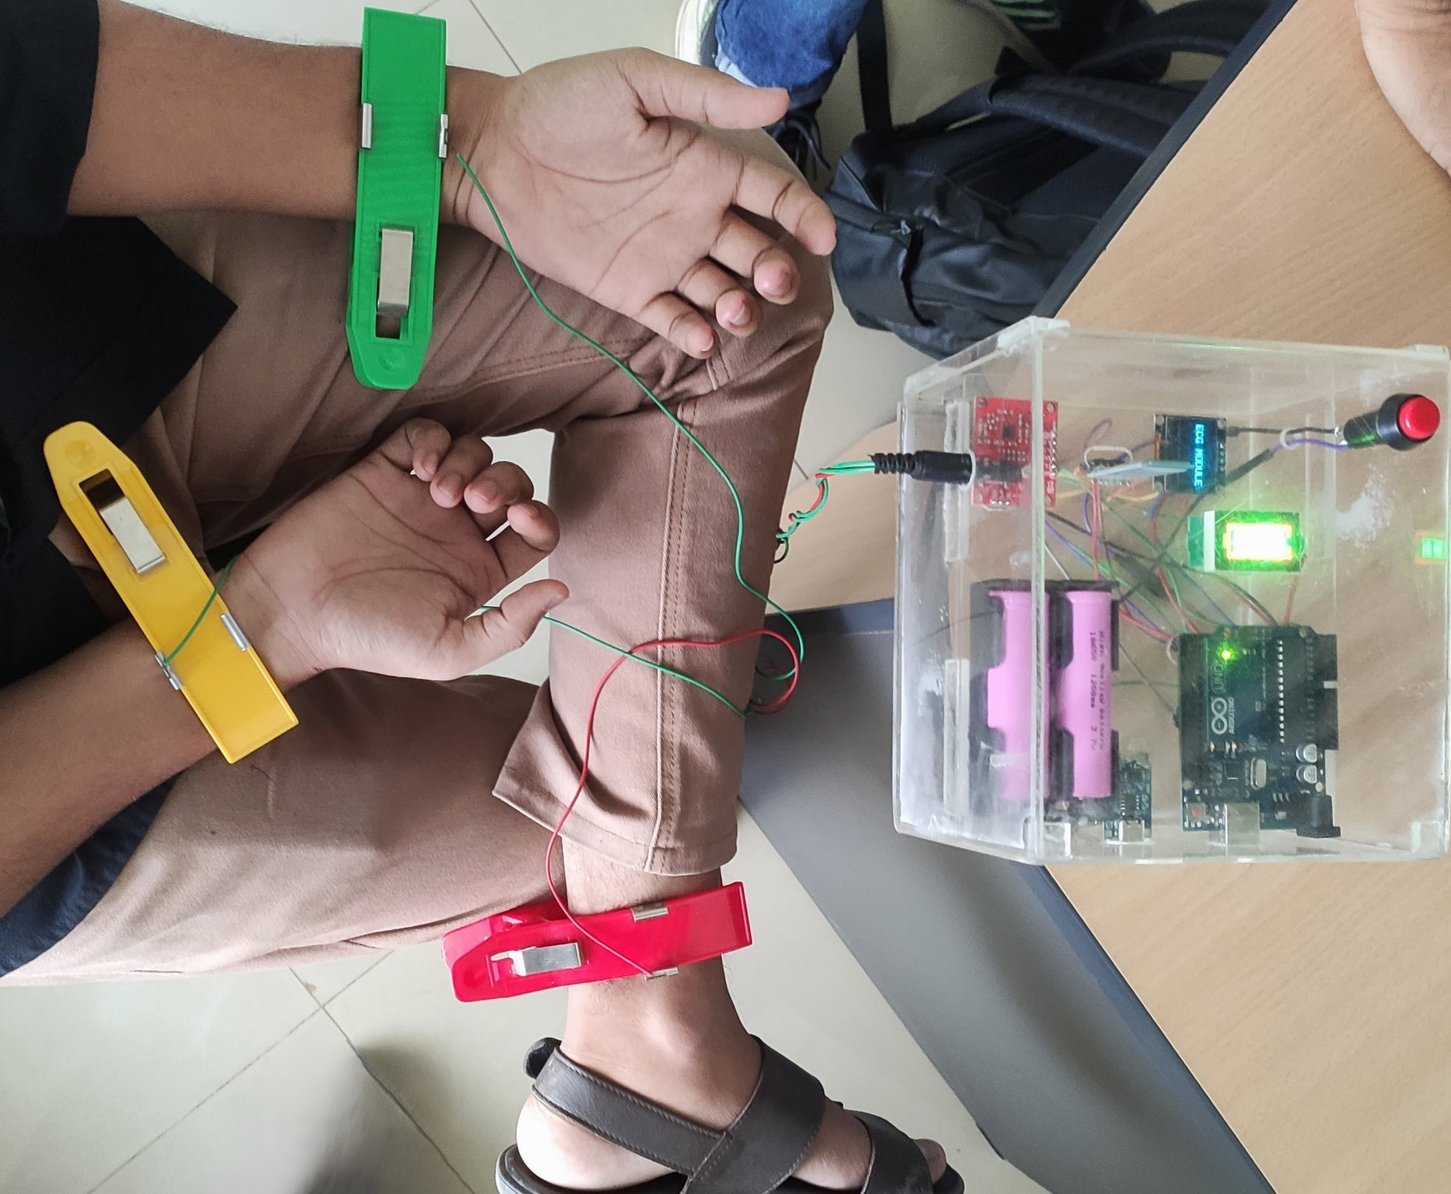
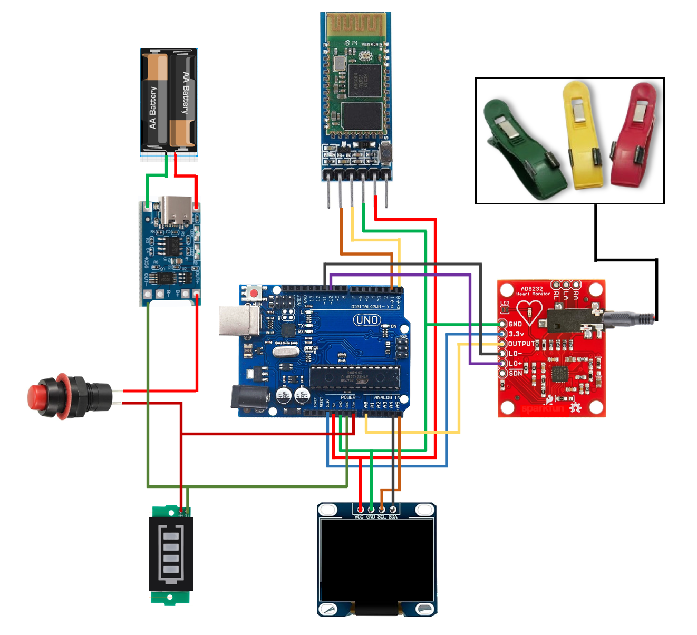
Schematic
Data Collecting
20
Department of EEE | 2024
Presented By
Ayman Zafar ; ID: 021 191 058

Slide 22
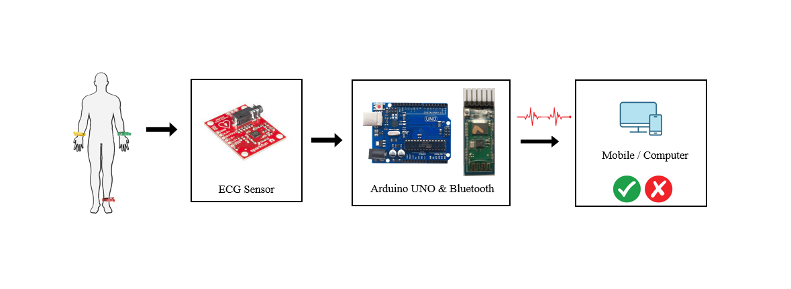
21
Flow Chart
Department of EEE | 2024
Presented By
Ayman Zafar ; ID: 021 191 058

Slide 23
Total Expense
22
SL | Components | Quantity |  | Price (Per Unit) | COST(TAKA)
 | ECG sensor AD8232 | 1 |  | 790 | 790
2. | Arduino-Uno | 1 |  | 890 | 890
3. | Electrodes | 1 |  | 1000 | 1000
4. | OLED Display | 1 |  | 450 | 450
5. | Bluetooth module | 1 |  | 350 | 350
6. | Battery | 2 |  | 70 | 140
7. | Battery Indicator | 1 |  | 45 | 45
8. | B. Charging module | 1 |  | 65 | 650
9. | Others |  |  | 1200 | 1200
Total = |  |  | 5515 tk
Department of EEE | 2024
Presented By
Ayman Zafar ; ID: 021 191 058

Slide 24
24
PROJECT TIMELINE
Hardware Setup
Final Task
Algorithm Implement
1. Procure ECG sensor hardware. 2. Set up hardware for data acquisition. 3. Ensure compatibility with machine learning model. 4. Conduct initial testing for functionality. 5. Integrate hardware with authentication system. 6. Validate hardware performance. 7. Finalize hardware configuration for deployment
1. Data acquisition. 2. Preprocessing. 3. Feature extraction. 4. Model training. 5. Evaluation.
6. Optimization. 7. Deployment
Hardware Testing
Hardware Design
Comparison
Task2
Task4
Task6
Task1
Task3
Task5
Code Investigation
Software Test: Data Bank
Software Test: Live Data
The code investigation for implementing ECG in biometric authentication using machine learning entails developing a comprehensive pipeline that preprocesses ECG signals, extracts key features, and trains a model to authenticate users based on these features, ensuring accuracy and robustness through evaluation metrics.
1. Data gathering from ECG sources. 2. Preprocessing for noise reduction. 3. Feature extraction, focusing on R-peaks. 4. Model training using machine learning algorithms. 5. Evaluation of model accuracy. 6. Optimizing model performance. 7. Integration into authentication system for testing.
1. Configure software environment for data processing. 2. Develop real-time data acquisition pipeline. 3. Implement preprocessing for noise reduction. 4. Extract features from live ECG data. 5. Train machine learning model using live data. 6. Evaluate model performance in real-time. 7. Optimize software for efficient processing.
Department of EEE | 2024
Presented By
Ayman Zafar ; ID: 021 191 058

Slide 25
CONCLUSION
25
Real-Time Data Collection
Enhanced Security
Accuracy and Reliability
Practical Real-Time Capabilities
Significant Advancement in Biometric Technology.
Department of EEE | 2024
Presented By
Ayman Zafar ; ID: 021 191 058

Slide 26
United International University | 2024
THANK YOU
Presented By:
Group 231 – 04
Department of EEE

